Slide 1

GROUP MEMBERS: SHANKARASUBRAMANIYAN GANAPATHI SUBRAMANIAN SAI PUNEETH CHINNAM PIYUSH KUMAR SULTANIA BISMITA BEHRA https://github.com/shankarasubramaniyan/DMDD.git
FLIGHT BOOKING MANAGEMENT SYSTEM

Slide 2
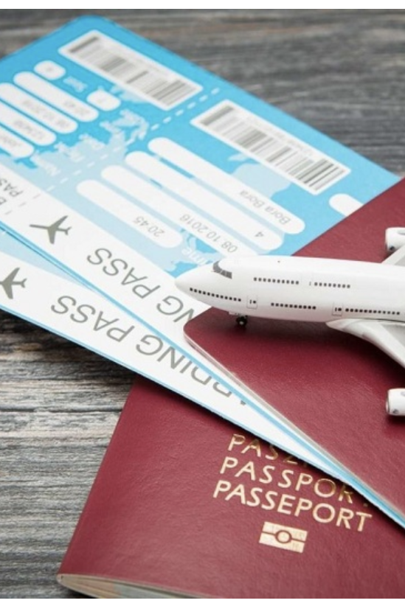
OBJECTIVE
This project aims at enhancing the relationship between the customers and airlines via the Flight Reservation System.
The system allows a passengers to perform various functions such as managing the flight bookings, and customer information.
Incorporate the COVID-19 digital test reports and vaccination details of the passengers for convenient and a safe journey.

Slide 3
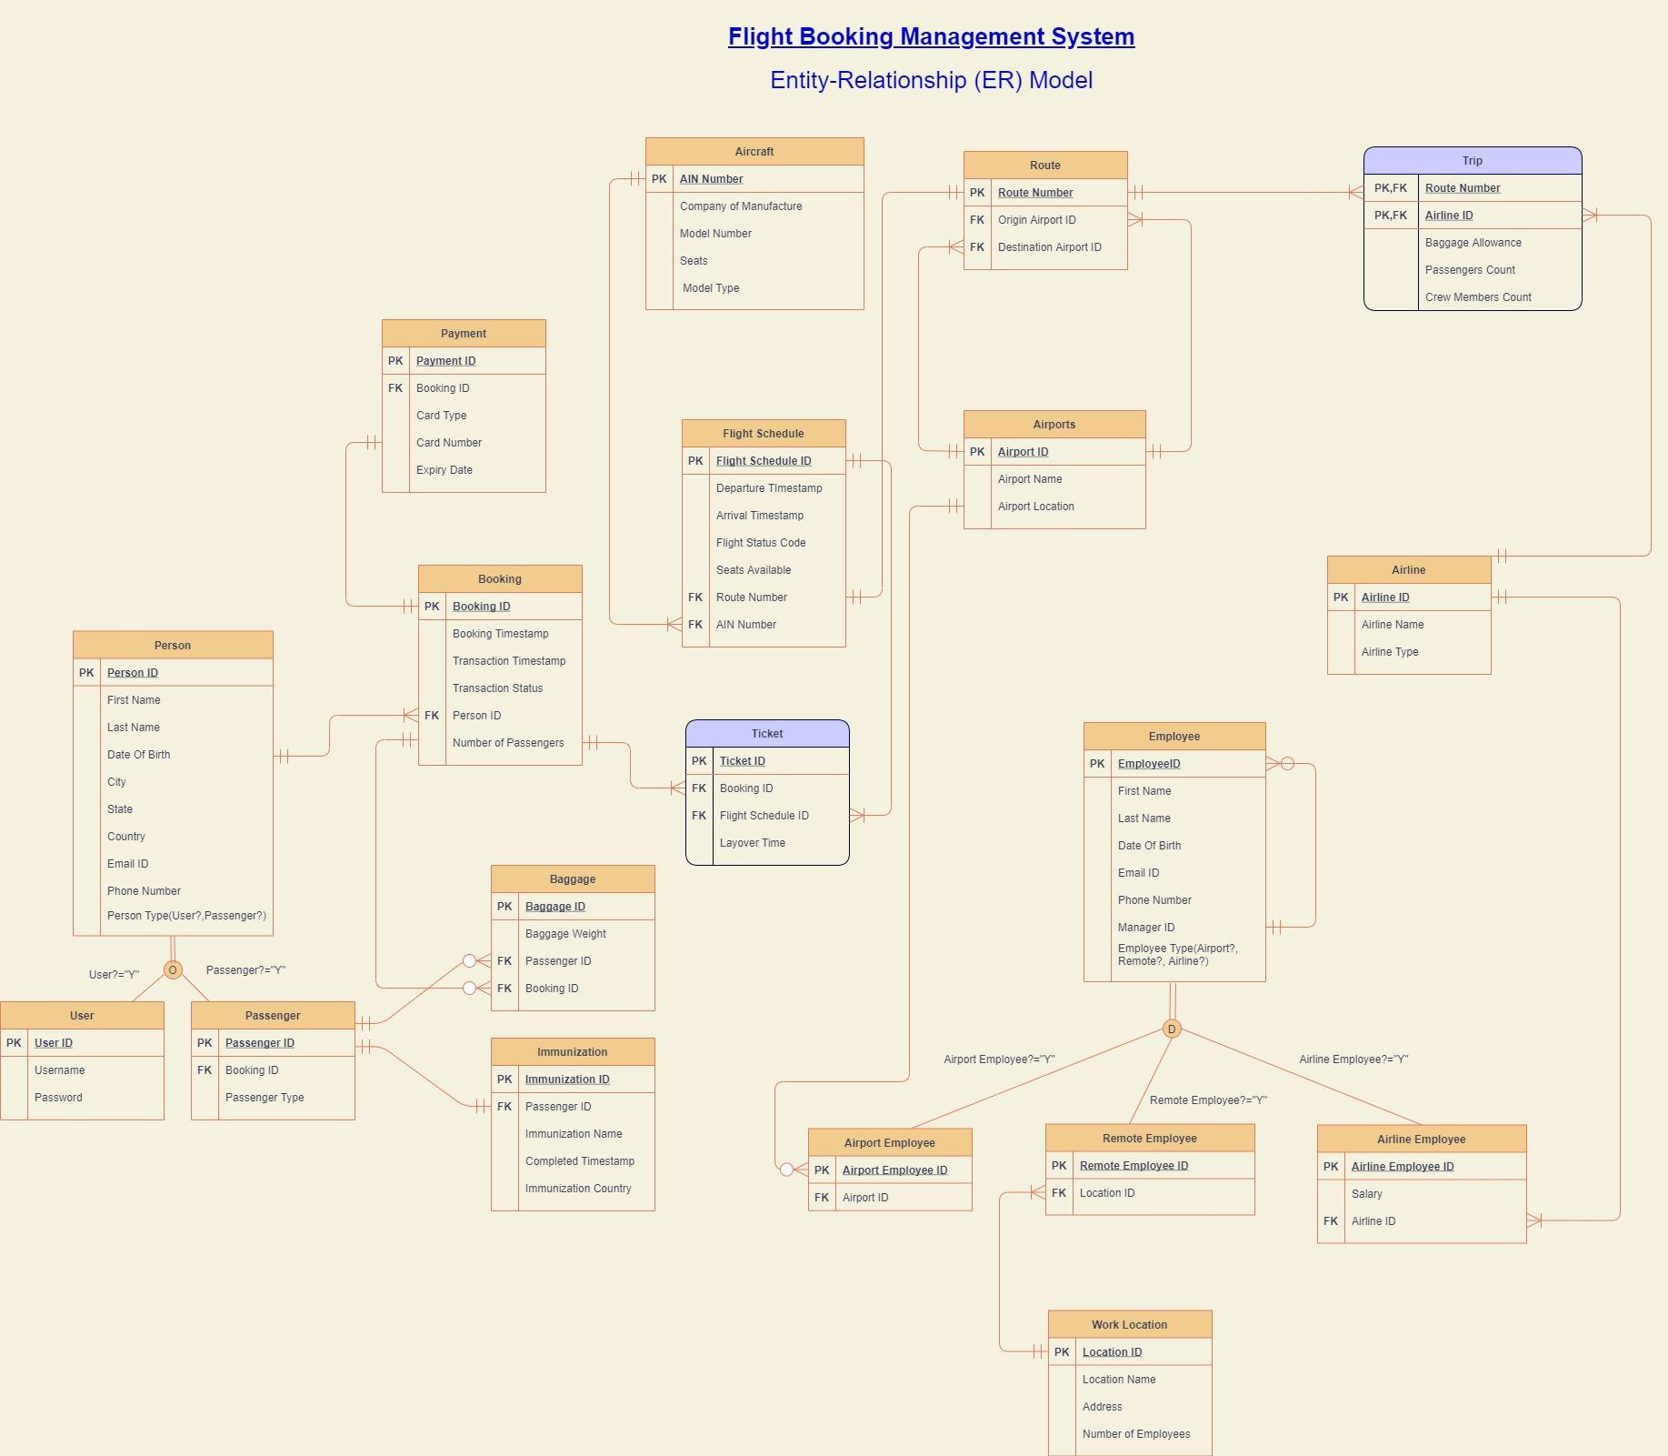

Slide 4


Design document
A total of twenty entities have been created and corresponding relationships have been established in the best possible normalized form which is suited for a database.
Attaching the design document with the entities, attributes with the description for each entity.

Slide 5

SQL STATEMENTS
SP,View,Trigger
Twenty tables have been created with each table containing 10 records.
The tables present in the database have table level check constraints, clustered and non clustered indexes, encryption in column, computed columns.
Corresponding stored procedures, triggers and views have ben created with the available data from the database
DDL
DML

Slide 6
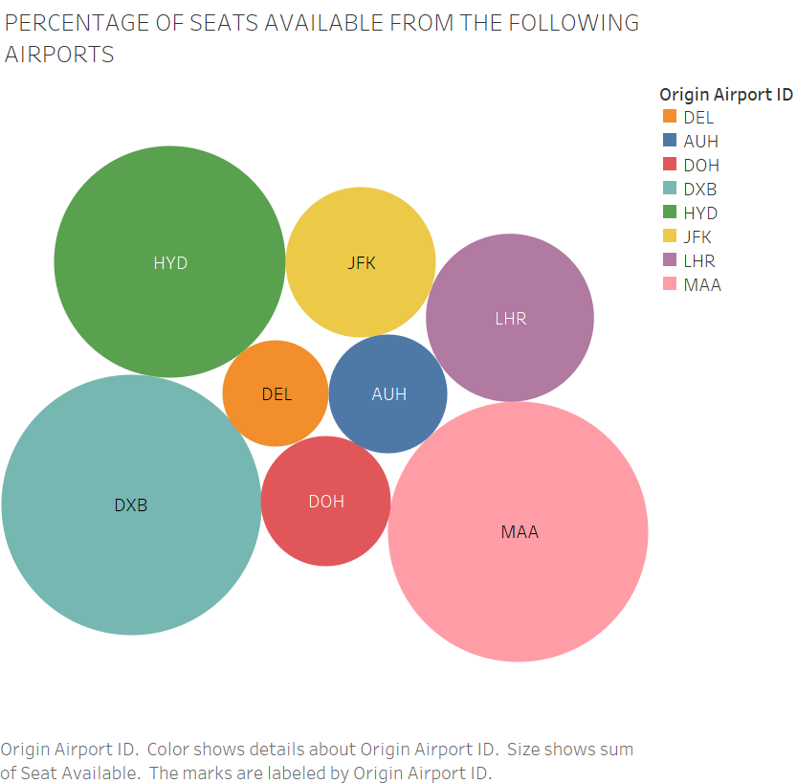
seats available at airports
The chart depicts the availability of seats in all the aircrafts from the originating airports.

Slide 7
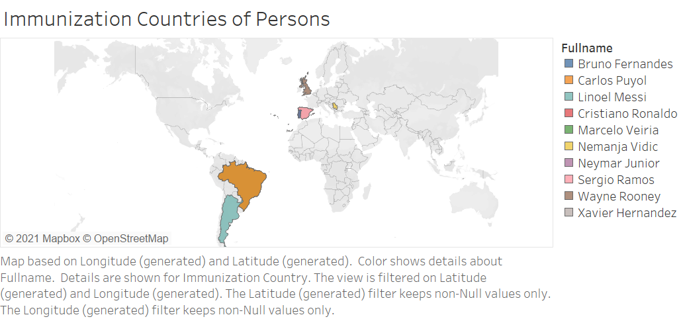
depicts the countries in which Passengers got vaccinated.

Slide 8
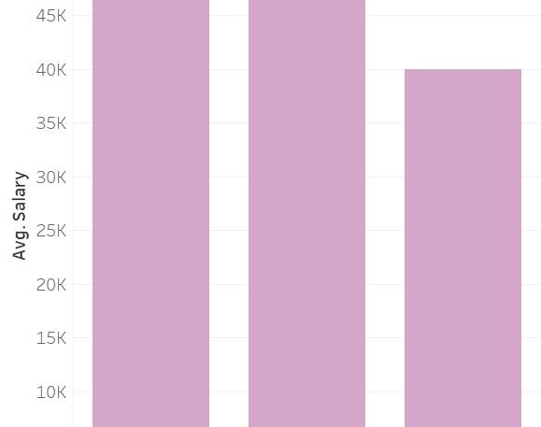
average salaries of the respective employee types
The graph depicts the average salary of the below three employee categories.
Airline Employee
Airport Employee
Remote Employee

Slide 9
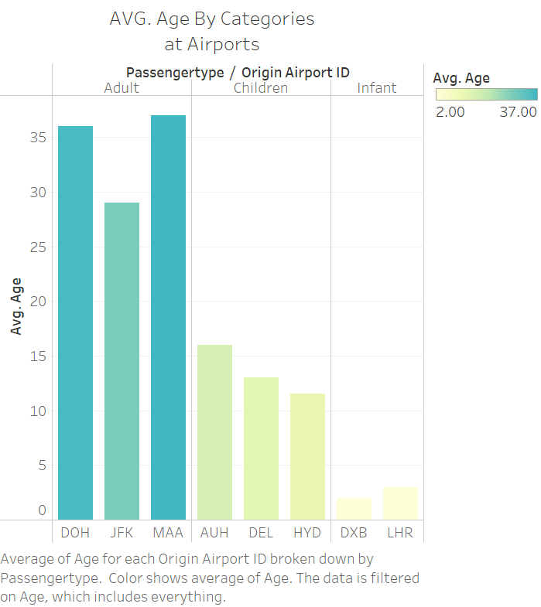
Average age of passengers at the respective Origin Airports
The graph depicts the average age of the passengers boarding at the respective airports and they are categorized into the following three types.
Adult
Children
Infant

Slide 10
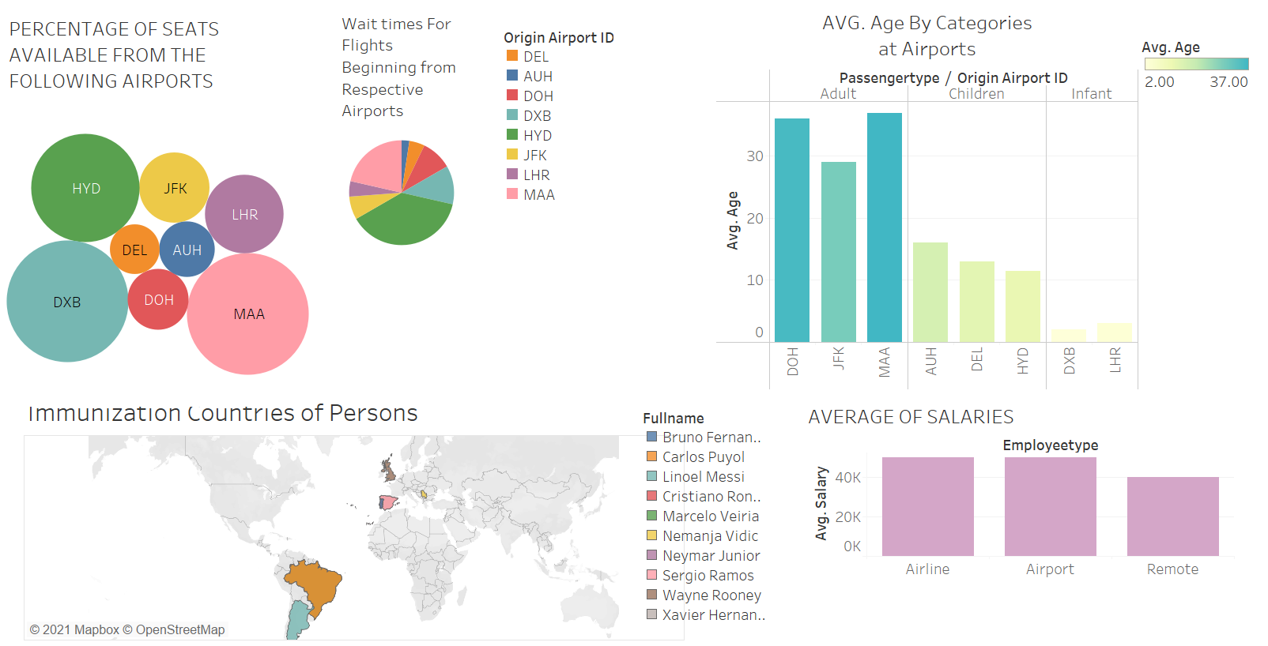

Slide 11

roles
All 4 members equally contributed during the first phase of the project which involves defining the entities and establishing the relationships, preparing the design document and the final ER diagram.
DDL - Each member covered 5 tables since there were 20 tables.
DML/Views- Shankar, Puneeth, Piyush
Stored Proc/Triggers- Shankar and Puneeth
Tableau Report- Shankar and Puneeth

